Slide 1
Presentation by:
Jean Luis Urena – ju5366@rit.edu
Jhanavi Lingamneni – jl7903@rit.edu
Sarvesh Kapil Pathak – sp5953@rit.edu
ICU Patient Risk
Assessment

Slide 2
PROBLEM STATEMENT
Predicting mortality in ICU patients is crucial for evaluating healthcare outcomes
ICU data - vital signs, lab results, and demographics collected over time
Difficult to identify high-risk patients early
Traditional methods (APACHE, SAPS-II) focus on group-level analysis, not individuals
Missing critical patients (false negatives) can be life-threatening
Notes:
Jhanavi

Slide 3
HYPOTHESIS
Early ICU data contains enough clinical information to predict mortality risk
Machine learning models can identify high-risk patients more effectively
Improving recall can help reduce missed critical cases
final prediction - RISK or NO RISK
Notes:
JHANAVI

Slide 4
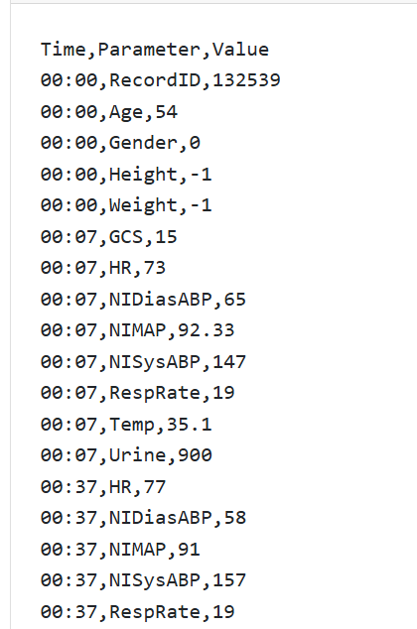
DATASET OVERVIEW
The PhysioNet Challenge 2012 Dataset
ICU patient data collected over first 48 hours
Used for predicting in-hospital mortality
Real-world clinical dataset from hospitals
Total patients: 12,000
Each patient stored as a separate file
3 columns - Time, Parameter, Value
37 clinical variables
Irregular sampling
Missing values
Imbalanced dataset
Target Variable
0 - Survived
1 - Died
Notes:
JHANAVI

Slide 5

Data Preprocessing
Before
After
Timeseries dataset with 43 columns
Some categorical values
Large variance in numbered values of vitals
2D tabular dataset with aggregated columns (369 features)
LSTM retained 3D
One-Hot encoded categorical values
Normalized numerical values
Median imputated NaN values
Notes:
SARVESH Feature transforming: Z-Score, One Hot Feature engineering: mean, median, min, max, last, first, missing, delta, range, etc.

Slide 6
Data Preprocessing
Raw data is 48 hours of irregular (Time, Parameter, Value) measurements per patient — pivoted into a wide table with vitals as columns
Each vital aggregated into 10 summary features: mean, median, min, max, std, first, last, delta, range, and a "missing" flag
-1 placeholder values replaced with Nan; missing values filled with median (or mode for Gender)
Final shape: 369 features per patient
Standard Scaler fit on training only; splits follow official challenge (set-a = train, set-c = validation, set-b = test)
Notes:
SARVESH

Slide 7
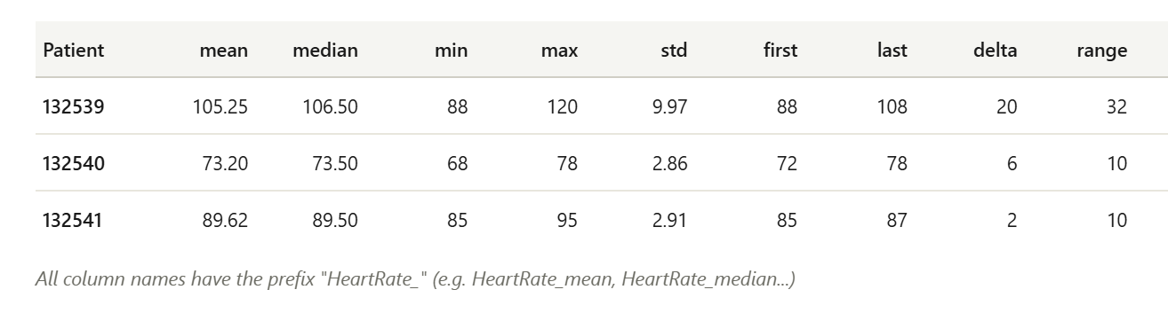
Data Preprocessing
Notes:
SARVESH

Slide 8
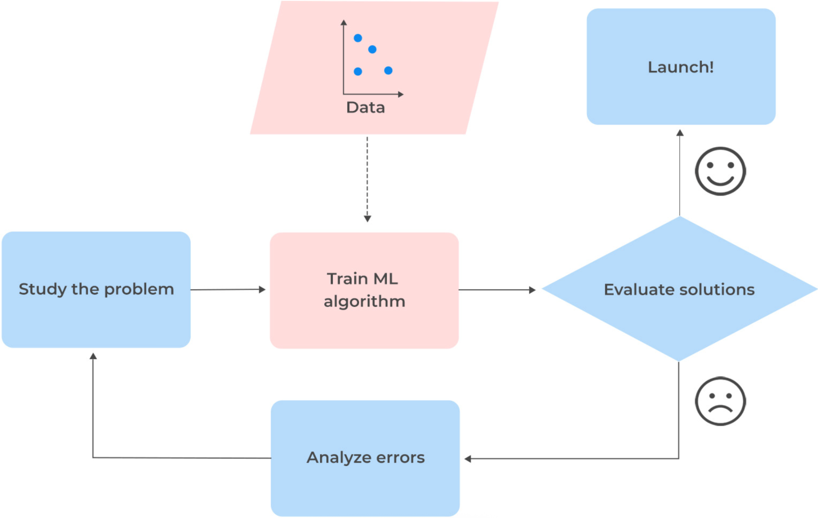
Method
Notes:
SARVESH

Slide 9
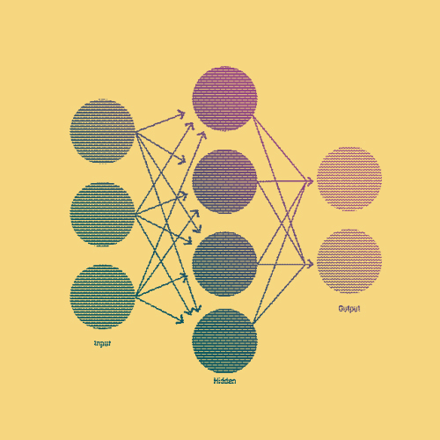
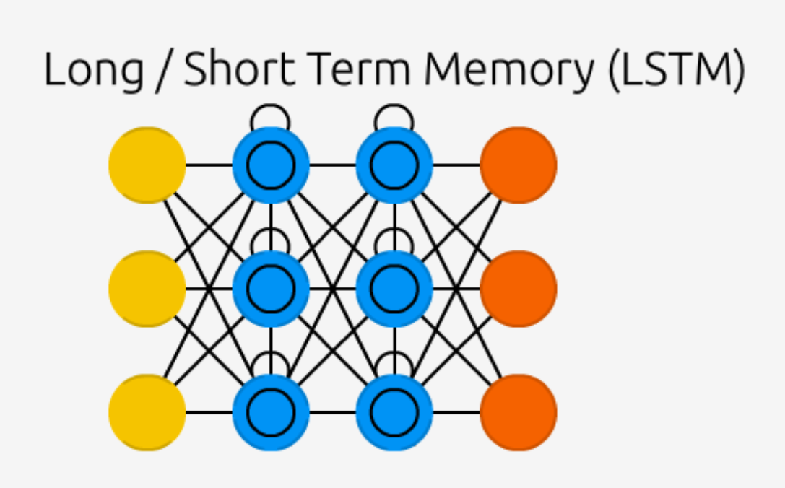
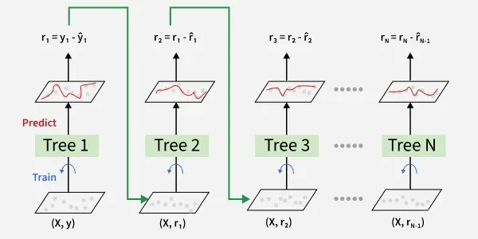
Models
Multi
Layer
Perceptron
Long ShortTerm Memory
Gradient Boosting
Notes:
SARVESH

Slide 10
MLP
Tensorflow + Keras
Good with large and complex non-linear data, like that of this dataset of vitals from an ICU.
Hyperparameters set using RandomizedSearchCV.
MLP is very flexible with regularization techniques to prevent overfitting, which in turn also improves generalization.
Regularizers:
EarlyStopping – Prevent overfitting
L2 – Prevent overfitting by adding penalties
Dropout – Prevent overfitting
BatchNormalization – Stabalize inputs with normalization
Calibration & Balance was required
IsotonicRegression – Smoothes trend after processing
Class Weights – To balance dataset imbalance and preserve true dataset distribution
Notes:
JEAN
Hyperparameters tuned with RandomizedSearchCV. Only 1 hidden layer with 10 units
Initial evaluation showed a lot of underfitting. Realized it was because the time series context was lost. Added aggregate *_first, *_last, *_range, *_delta to preserve some temporal context.
Then it was overfitting and had to aggressively control it with regularizers.
Finally, predictions were poorly calibrated had to use IsotonicCalibration to smooth out the the noisy trend.

Slide 11
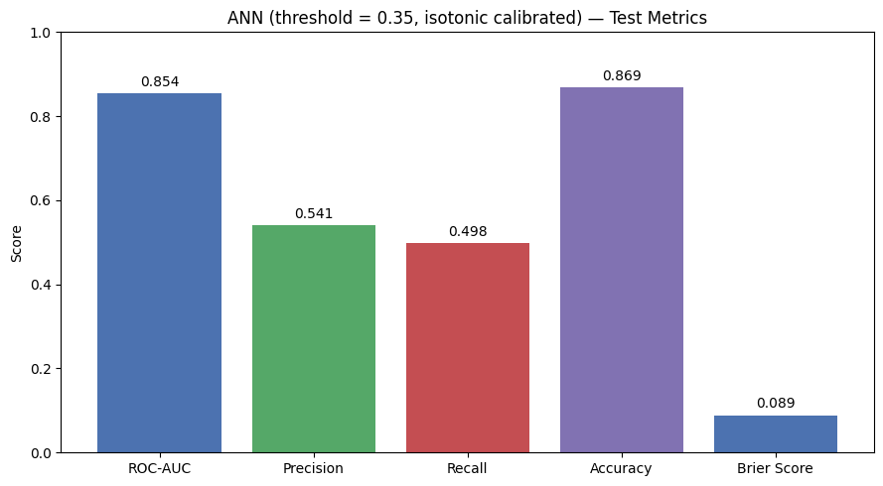
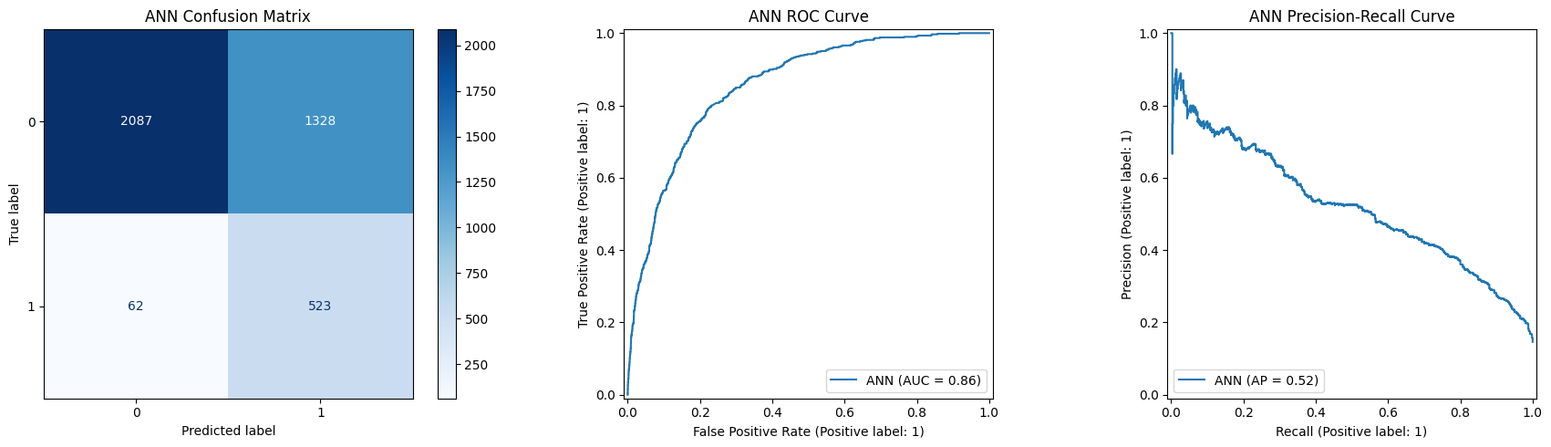
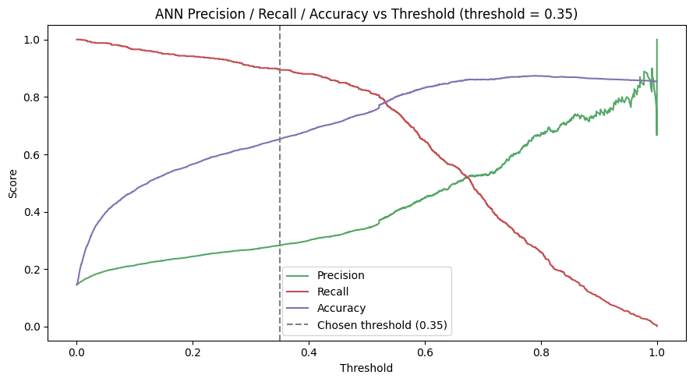
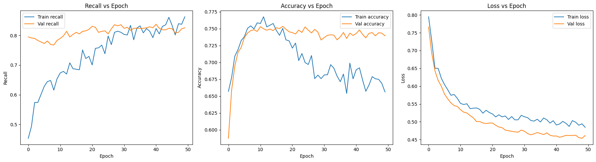
Multi-Layer Perceptron (MLP)
Notes:
JEAN

Slide 12
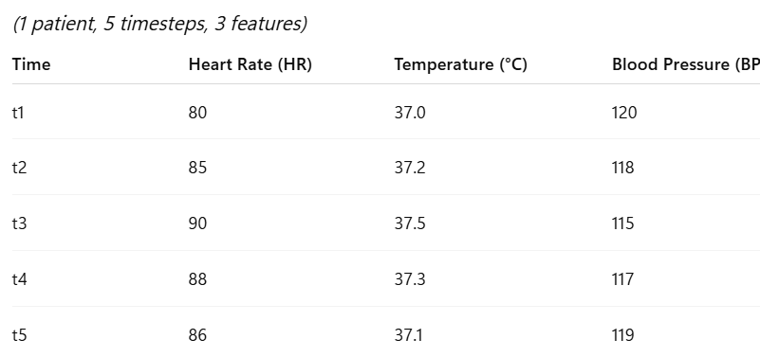
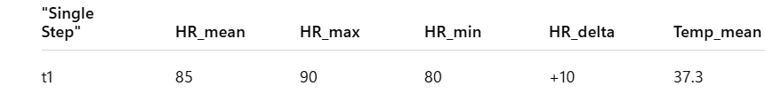
Long Short-Term Memory (LSTM)
Designed for sequential / time-series data
Captures temporal dependencies using memory cells
Input reshaped from 2D → 3D (samples, timesteps, features)
Used to model relationships across patient vitals
Notes:
JHANAVI

Slide 13
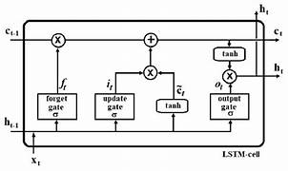
LSTM Architecture
uses gating mechanisms
ReduceLROnPlateau - automatically reduces learning rate when the model stops improving.
Activation Functions : Sigmoid, ReLU
Learning rate: 0.0003
threshold = 0.23
Used class weights
Notes:
JHANAVI

Slide 14
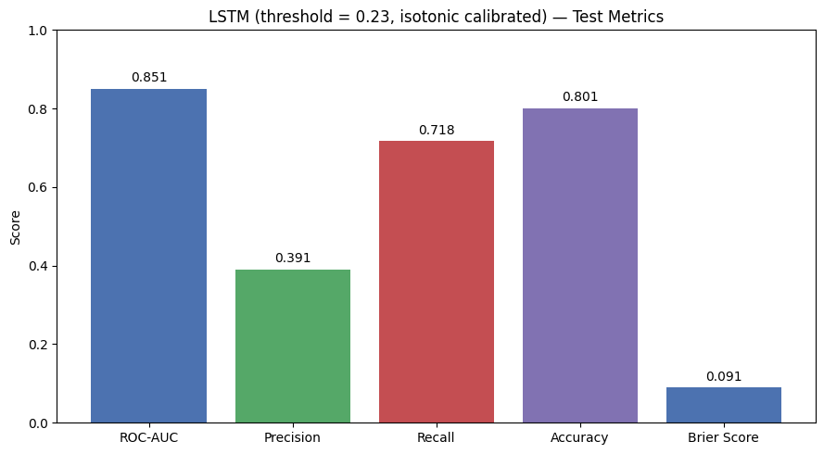
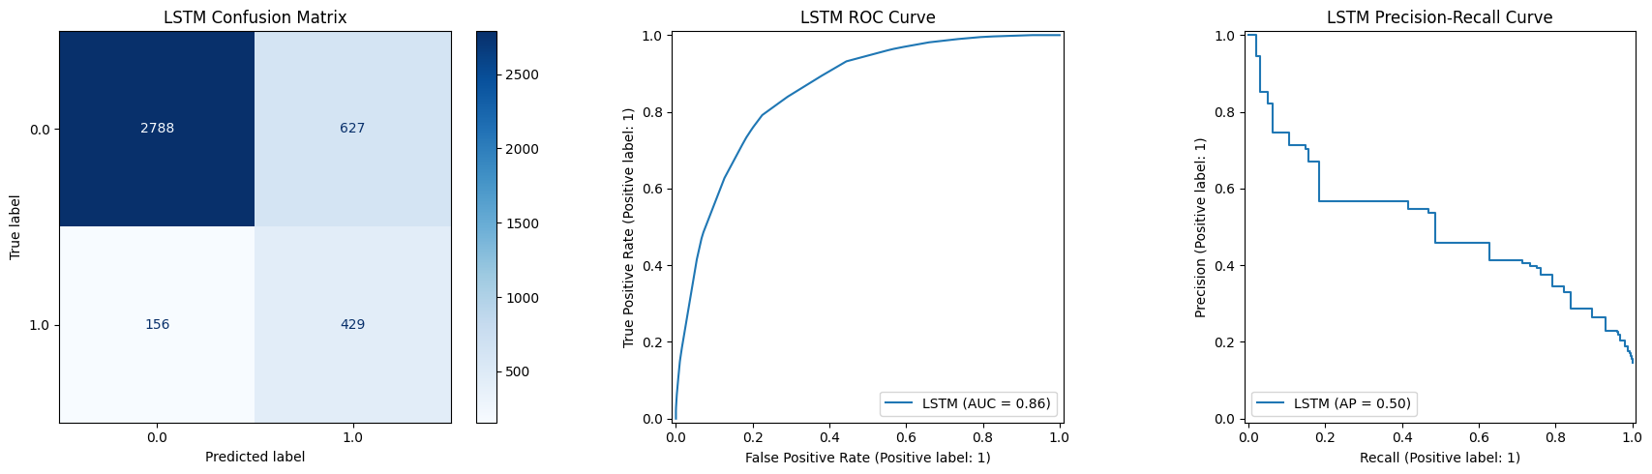
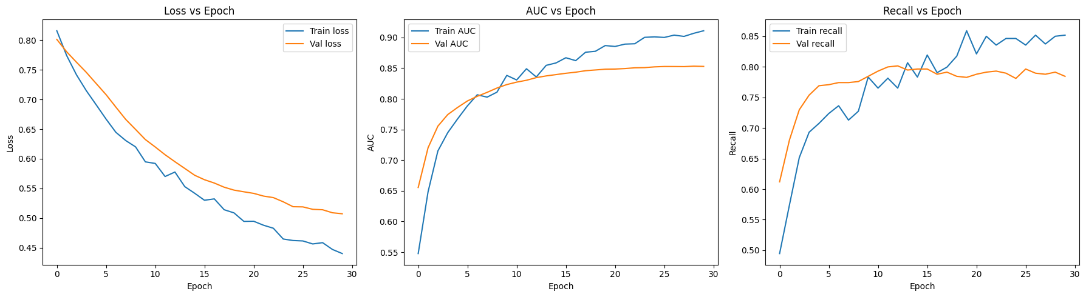
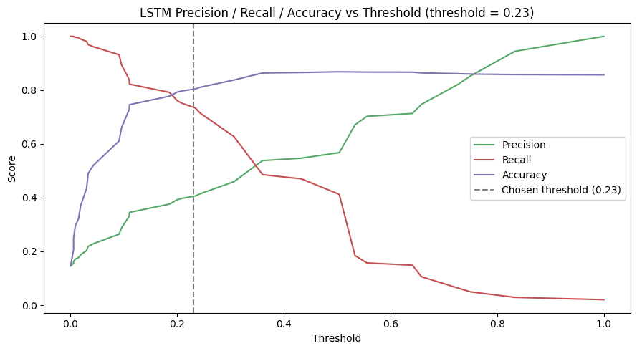
LSTM
Notes:
JHANAVI

Slide 15
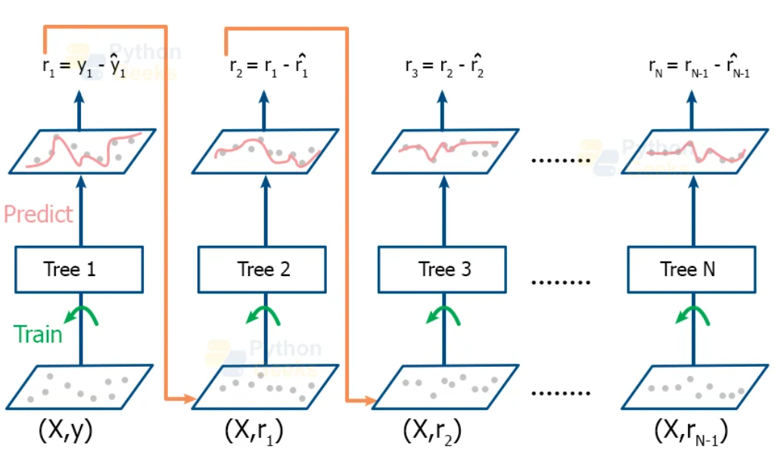
Gradient Boosting
Notes:
SARVESH

Slide 16
Gradient Boosting
Enemble method that builds 500 shallow decision trees sequentially, where each new tree corrects the errors of the previous ones
Hyperparameters tuned via GridSearchCV:
Learning rate: 0.03 (small steps prevent overfitting)
Max depth: 4 (shallow "weak learner" trees)
N estimators: 500 (trees in the ensemble)
Subsample: 1.0 (each tree trained on 100% of data — adds regularization)
Max features: sqrt (random feature subset per split)
Min samples leaf: 5 (prevents overly specific splits)
Trained on the full dataset — no undersampling, since more data improved performance
Decision threshold lowered to 0.23 to catch more at-risk patients (prioritizing recall over precision for ICU safety)
Results on test set: 69% accuracy, 67% recall on death class, SE1 score of 0.48 — close to the 2012 PhysioNet challenge winner (0.53)
Notes:
SARVESH

Slide 17
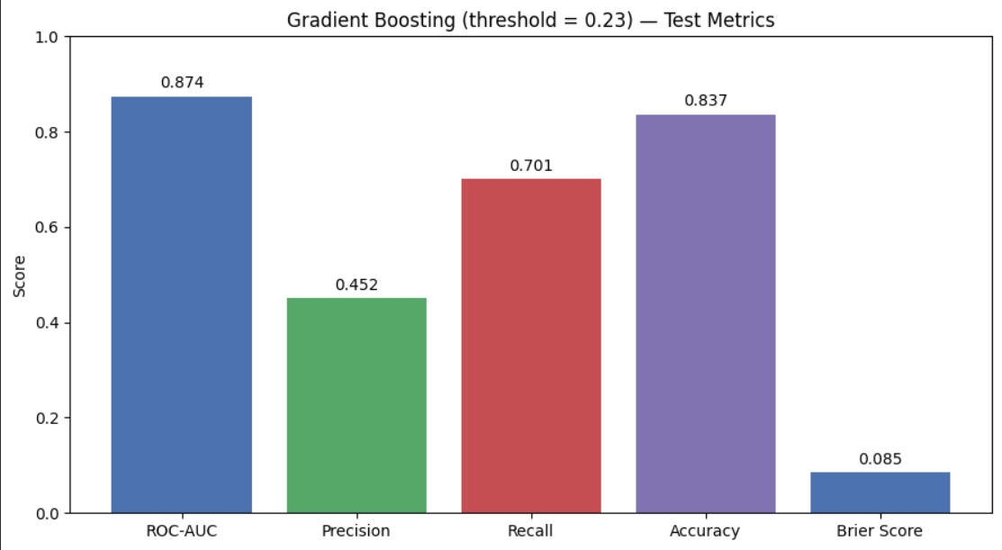
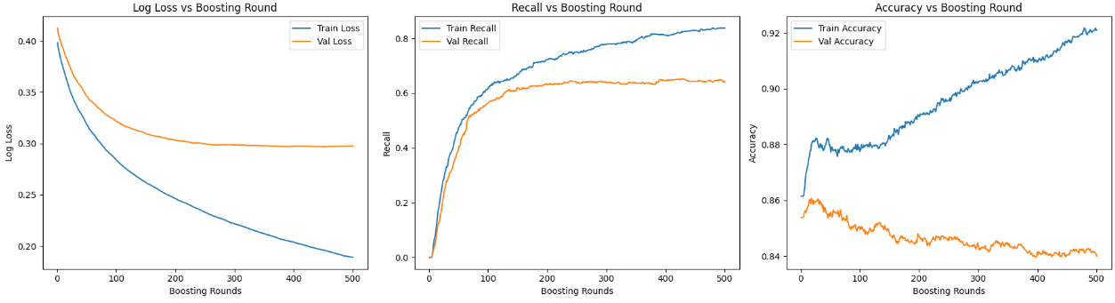
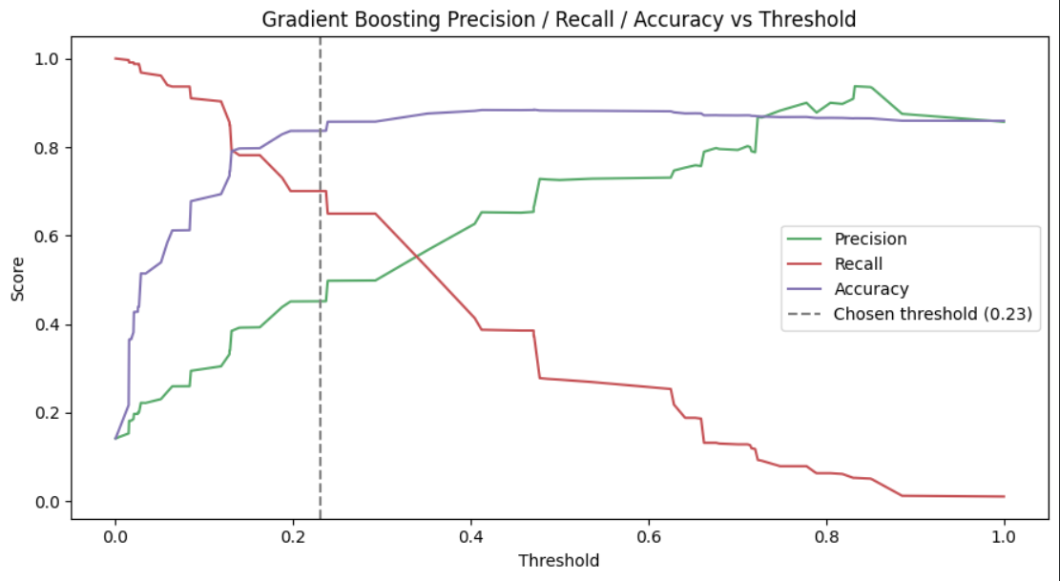
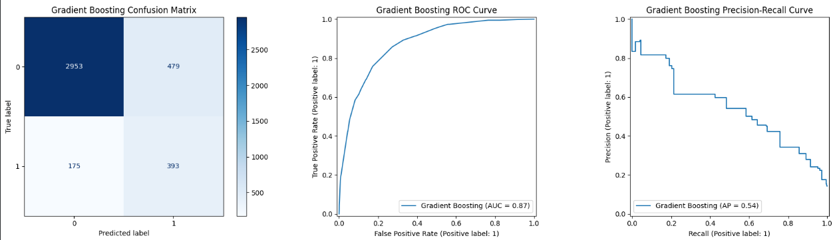
Gradient Boosting
Notes:
SARVESH

Slide 18
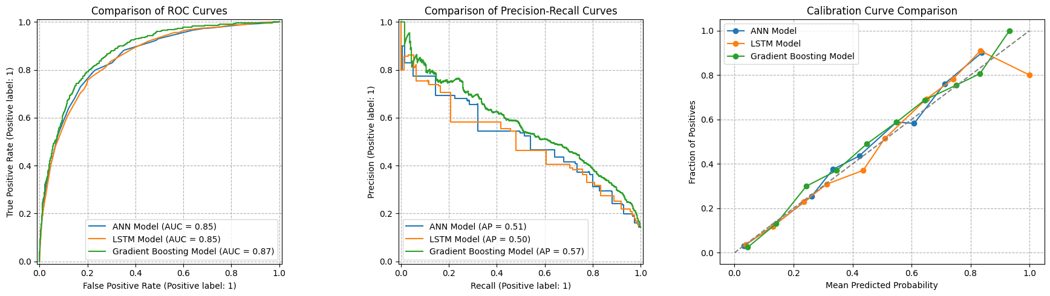

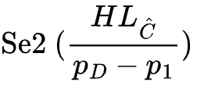
Model Comparison
Challenge Comparison
 | Winner | Contestant | Jean | Jhanavi | Sarvesh
 | 0.53 | 0.27 | 0.50 | 0.39 | 0.48
 | 26.44 | 22.83 | 55.90 | 19.71 | 54.66
Model | Bayesian Ensemble | MLP | MLP | LSTM | Gradient Boosting
Notes:
JEAN
HOSMER-LEMESHOW H-STATISTIC - SE2 - weight squared distance between actual and predicted frequencies - how far is it from perfect 45 degree angle of calibration curve

Slide 19
Demo
Notes:
Jean RISK: 80; 30; 2; 5; 20; 90; 37.8; 100 NO RISK: 30; 10; 70; 1.0; 15; 22.0; 70.0; 37.0; 800

Slide 20
Acknowledgements and References
Physionet – For providing the uncleaned dataset
https://www.cinc.org/archives/2012/pdf/0249.pdf
https://physionet.org/content/challenge-2012/1.0.0/
A Simple Guide to Choosing the Right ML Model Every Time – https://archive.ph/SRnvM
Notes:
JEAN

Slide 21
Thank you!
Questions?
Notes:
JEAN

